Slide 1

Winning the Space Race
With Data Science
Heath Barnett
October 16, 2023

Slide 2
Executive Summary
Introduction
Methodology
Results
Conclusion
Appendix
Outline

Slide 3
Summary of Methodologies
Summary of Results
Executive Summary
Data Collection with API and Web Scraping
Data Wrangling and Formatting
Exploratory Data Analysis
SQL
Visualizations
Jupyter Notebooks
Folium Maps
Dashboard with Plotly Dash
Classification with Machine Learning
Exploratory Data Analysis
Query Results
Graphs
Interactive Folium Map
Interactive Dashboard
Machine Learning Predictions for several models
Decision Tree
k-Nearest Neighbors
Logistic Regression
Support Vector

Slide 4

Introduction
Predicting whether the Falcon 9 first stage will land successfully is a complex task that involves various factors, including:
Payload
Orbits
Booster Types
Geographical Information of Launch Sites
Success and Failure Rates
While SpaceX has made significant advancements in rocket reusability and has successfully landed many Falcon 9 first stages, there are still risks involved in each launch.
To make an accurate prediction of the success rate for future versions of Falcon 9, we will need to employ a variety of data science methodologies and machine learning techniques.

Slide 5
Section 1
Methodology

Slide 6
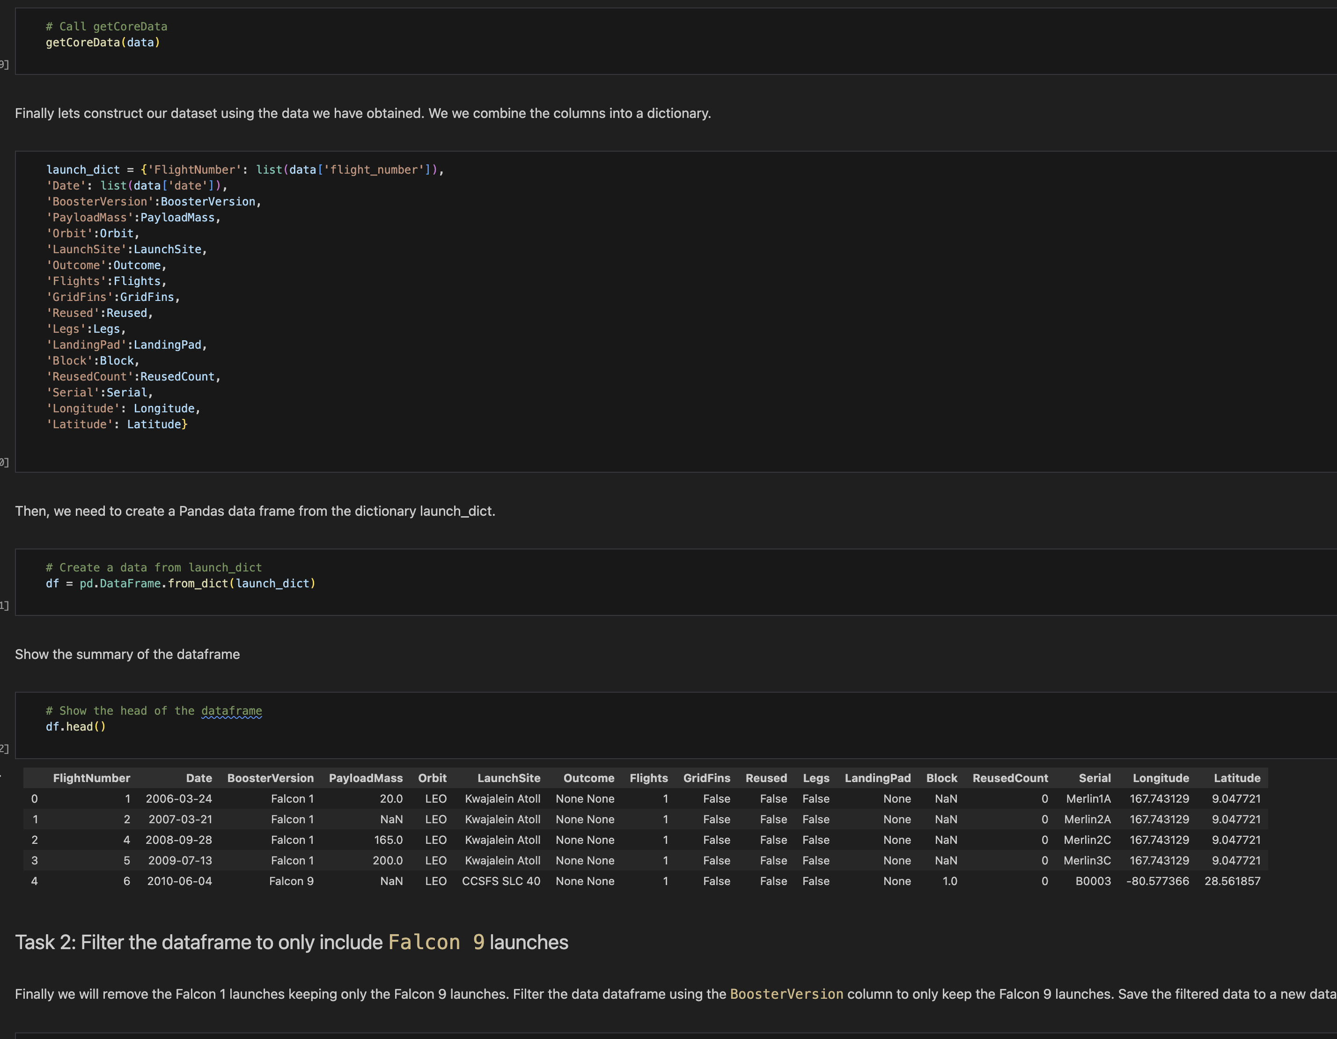
Data Collection – SpaceX API
Python package request to get content.
Response content imported as a JSON file.
JSON data converted to Pandas dataframe.
Cleaned data for missing values, replacing with averages.
Filtered data in various ways to ensure integrity.
https://github.com/heath-barnett/ibm_ds_cert/blob/main/jupyter-labs-spacex-data-collection-api.ipynb

Slide 7
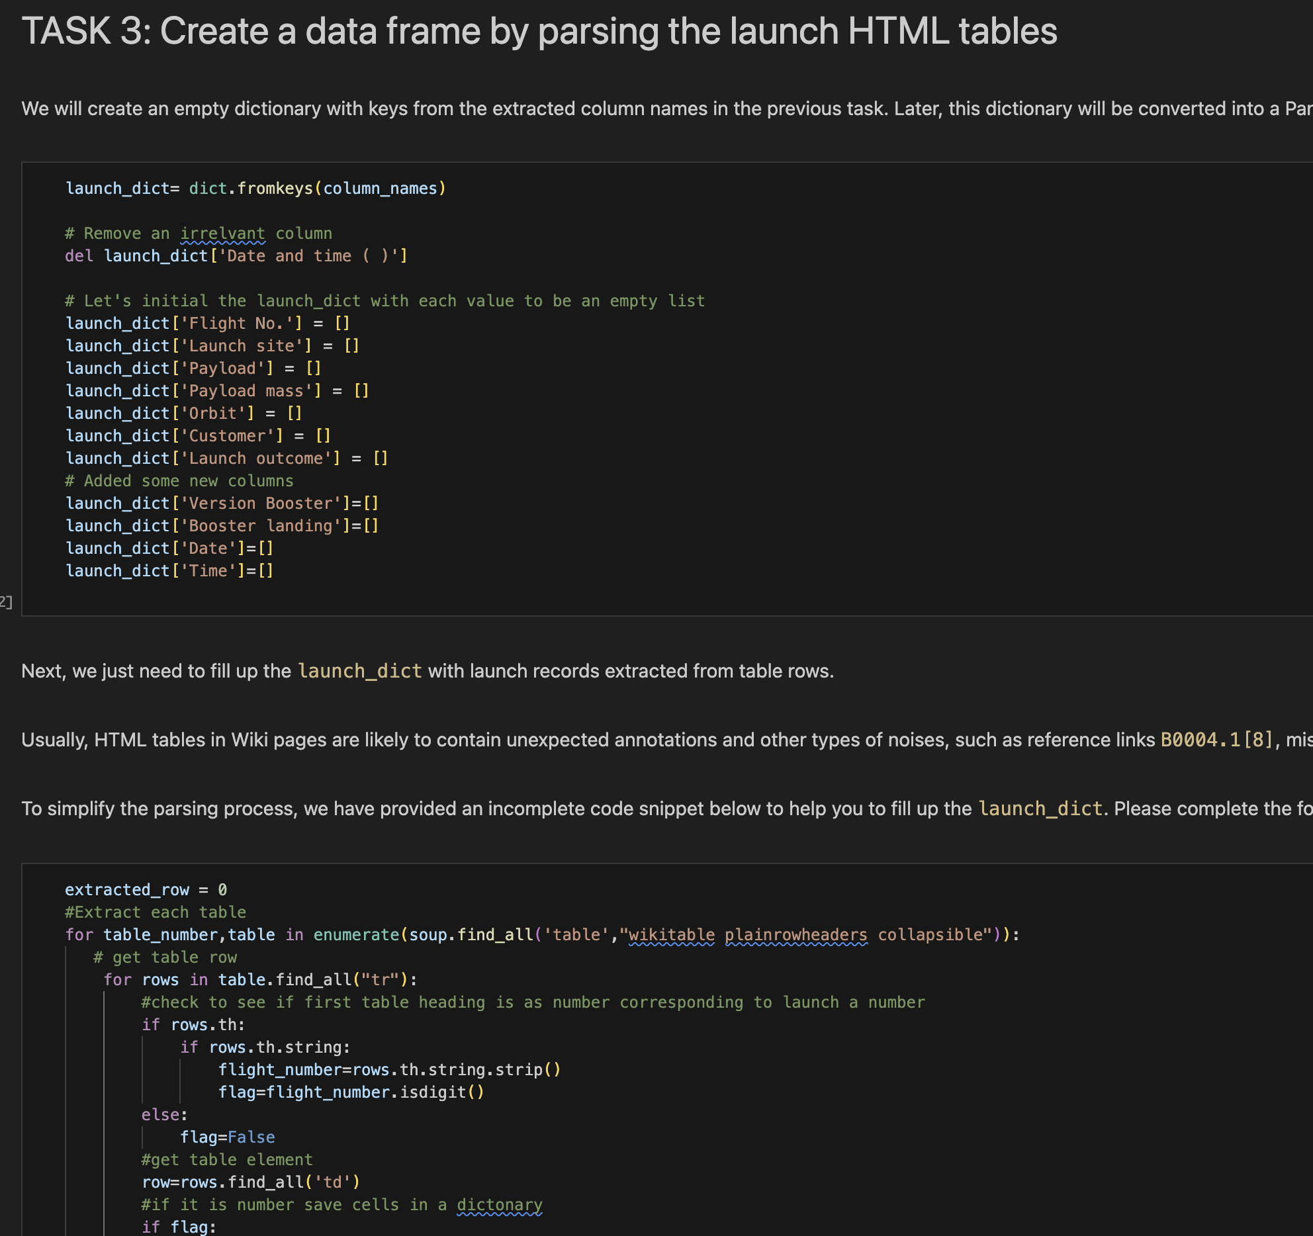
Data Collection - Scraping
Web Scraping with Beautiful Soup
Wikipedia data for Falcon 9 launch records.
Results converted to pandas dataframe.
https://github.com/heath-barnett/ibm_ds_cert/blob/main/jupyter-labs-webscraping.ipynb

Slide 8
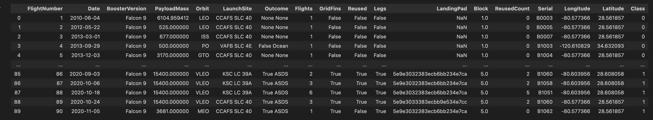
Data Wrangling
Filtered data for only Falcon 9 booster version.
Calculated a variety of parameters including launches at each site
and success rates by several categories.
Results exported to csv data files for later use.
https://github.com/heath-barnett/ibm_ds_cert/blob/main/labs-jupyter-spacex-Data%20wrangling.ipynb

Slide 9
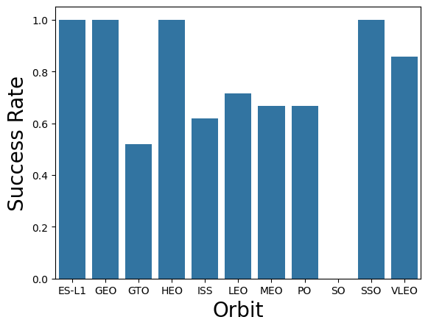
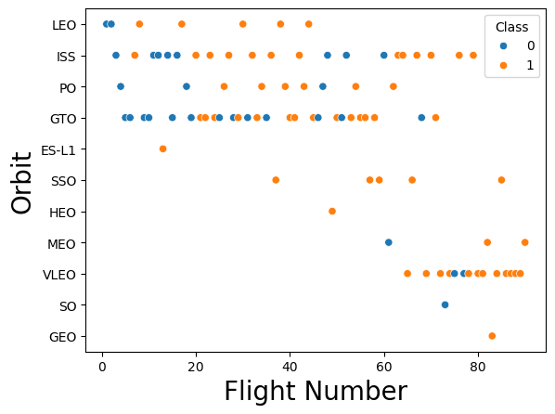
Exploratory Data Analysis with Data Visualization
Figure | Plot Type | Data
Figure 1 | Categorical | Flight Number vs Launch Site
Figure 2 | Categorical | Payload vs Launch Site
Figure 3 | Bar Chart | Success Rate vs Orbit
Figure 4 | Scatter | Flight Number vs Orbit
Figure 5 | Categorical | Payload vs Orbit
Figure 6 | Line | Annual Success Rate
https://github.com/heath-barnett/ibm_ds_cert/blob/main/jupyter-labs-eda-dataviz.ipynb.jupyterlite.ipynb

Slide 10
Exploratory Data Analysis with SQL
%%sql
SELECT Booster_Version as 'Booster', PAYLOAD_MASS__KG_ AS 'Payload Mass (kg)', Landing_Outcome AS 'Outcome'
FROM SPACEXTABLE
WHERE Landing_Outcome = 'Success (drone ship)'
AND PAYLOAD_MASS__KG_ BETWEEN '4000' AND '6000'
SQL Commands/Queries Used
SELECT
FROM
DISTINCT
WHERE
BETWEEN
LIKE
LIMIT
MIN
MAX
SUM
COUNT
%%sql
SELECT *
FROM SPACEXTABLE
WHERE Launch_Site
LIKE 'CCA%'
LIMIT 5
%%sql
SELECT Customer, SUM(PAYLOAD_MASS__KG_)
FROM SPACEXTABLE
WHERE Customer = 'NASA (CRS)'
https://github.com/heath-barnett/ibm_ds_cert/blob/main/jupyter-labs-eda-sql-coursera_sqllite.ipynb

Slide 11
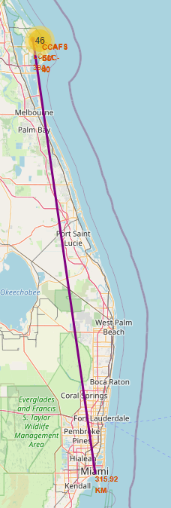
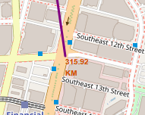

Build an Interactive Map with Folium
Marked all launch sites
Assigned all sites with success or failure makers.
Calculated distances between several objects and displayed the results with line features.
Distance of 315.92 km.
https://github.com/heath-barnett/ibm_ds_cert/blob/main/IBM-DS0321EN-SkillsNetwork_labs_module_3_lab_jupyter_launch_site_location.jupyterlite.ipynb

Slide 12
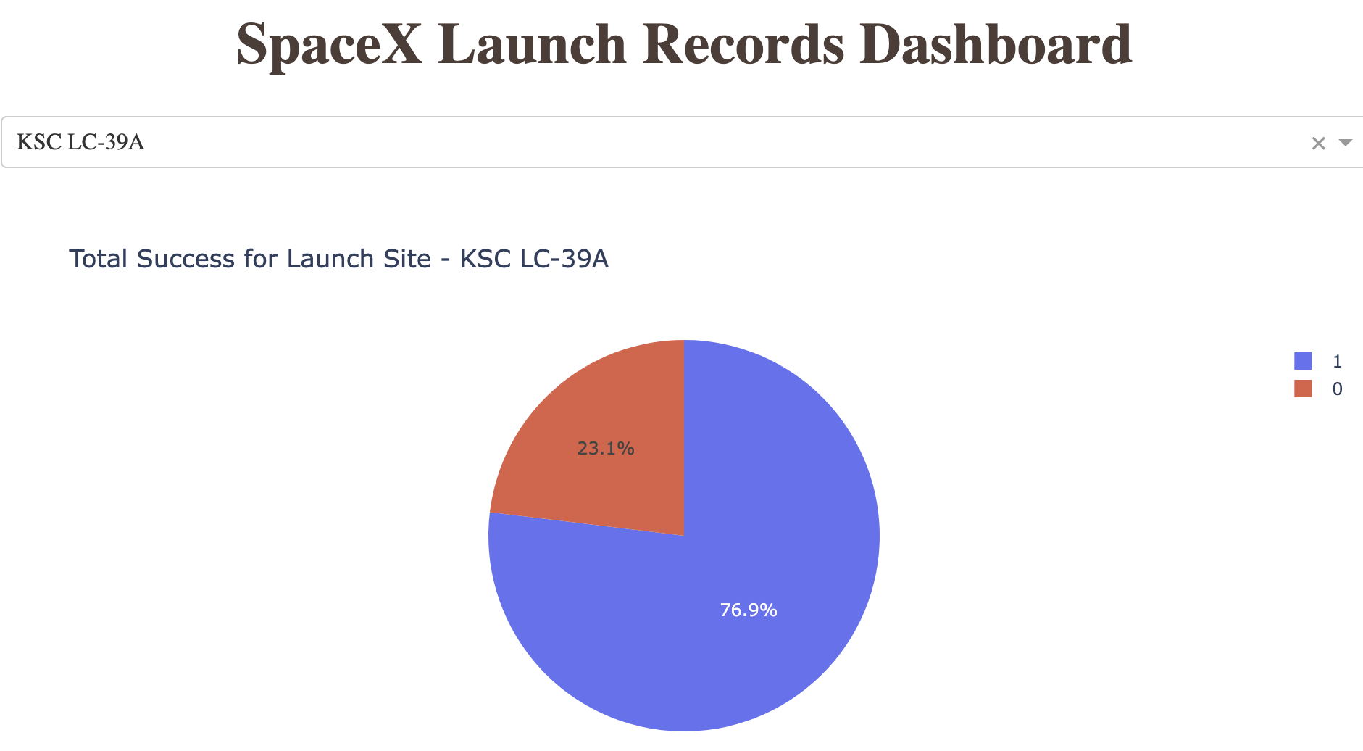

Build a Dashboard with Plotly Dash
Pie Charts for Each Launch that show success and failure rates.
Scatter plots showing the relationship between success/failure and payload with an adjustable slider for payload selection.

Slide 13
Predictive Analysis (Classification)
Data imported with pandas
Transformed with sci-kit learn
Split data into test/training sets
Machine Learning models parameters were optimized with grid-cv search
Models investigated:
Decision tree, knn, SVM, log regression
Accuracy on test sets were calculated and confusion matrices were produced
https://github.com/heath-barnett/ibm_ds_cert/blob/main/IBM-DS0321EN-SkillsNetwork_labs_module_4_SpaceX_Machine_Learning_Prediction_Part_5.jupyterlite.ipynb

Slide 14
Results
Exploratory data analysis results
Interactive analytics demo in screenshots
Predictive analysis results

Slide 15
Section 2
Insights from Exploratory Data Analysis

Slide 16
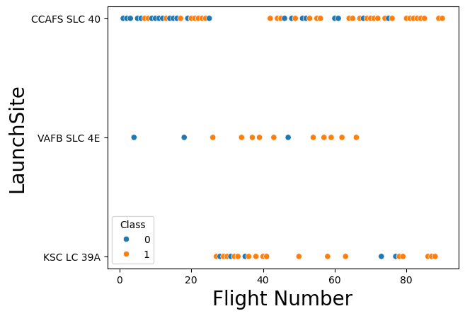
Flight Number vs. Launch Site
Data indicates that as flight numbers increase, the chance of success also increases.
https://github.com/heath-barnett/ibm_ds_cert/blob/main/jupyter-labs-eda-dataviz.ipynb.jupyterlite.ipynb

Slide 17
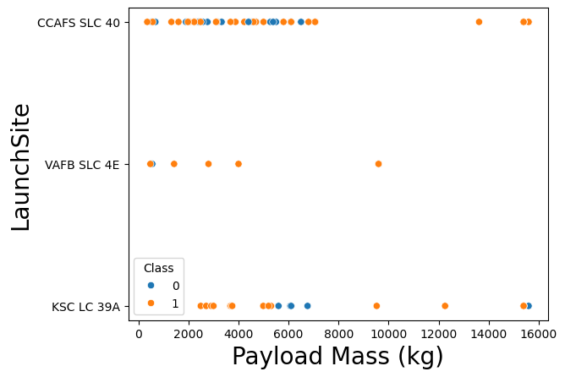
Payload vs. Launch Site
There is no clear relationship between payload mass and the launch site for CCAFS SLS 40 and KSC LC 39A.
Launch site VAFB SLC 4E does show consistent success rates regardless of payload.
https://github.com/heath-barnett/ibm_ds_cert/blob/main/jupyter-labs-eda-dataviz.ipynb.jupyterlite.ipynb

Slide 18
Success Rate vs. Orbit Type
Several orbit types have high success rates at or near 100%.
ES-L1, GEO, HEO, SSO and VLEO
SO orbit always fails.
https://github.com/heath-barnett/ibm_ds_cert/blob/main/jupyter-labs-eda-dataviz.ipynb.jupyterlite.ipynb

Slide 19
Flight Number vs. Orbit Type
Early flight numbers are more likely to fail regardless of orbit. Consistent with previous findings regarding flight numbers and launch sites.
Some orbit types are not attempted until much later in development cycle.
https://github.com/heath-barnett/ibm_ds_cert/blob/main/jupyter-labs-eda-dataviz.ipynb.jupyterlite.ipynb

Slide 20
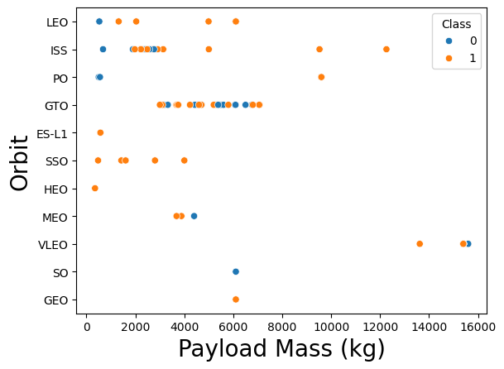
Payload vs. Orbit Type
With heavy payloads the successful landing or positive landing rate are more for Polar,LEO and ISS.
GTO is inconclusive, positive landing rate and negative landing(unsuccessful mission) are both relatively equal in the payload range of 3500 to 7000.
https://github.com/heath-barnett/ibm_ds_cert/blob/main/jupyter-labs-eda-dataviz.ipynb.jupyterlite.ipynb

Slide 21
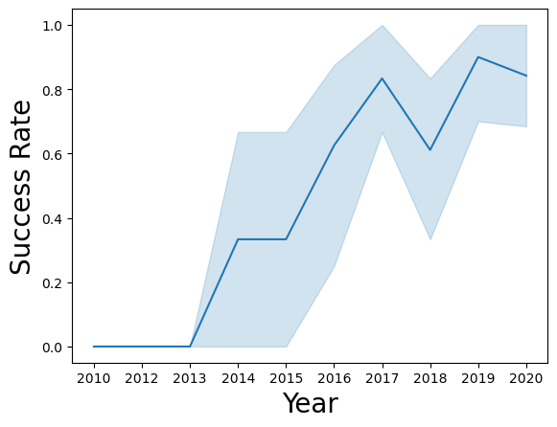
Launch Success Yearly Trend
Launch success on a steady increase from 2013 and 2017.
2018 show a downturn but the following year success rates rebounded.
https://github.com/heath-barnett/ibm_ds_cert/blob/main/jupyter-labs-eda-dataviz.ipynb.jupyterlite.ipynb

Slide 22
All Launch Site Names
Launch_Site
CCAFS LC-40
VAFB SLC-4E
KSC LC-39A
CCAFS SLC-40
%%sql
SELECT DISTINCT Launch_Site
FROM SPACEXTABLE
https://github.com/heath-barnett/ibm_ds_cert/blob/main/jupyter-labs-eda-sql-coursera_sqllite.ipynb

Slide 23
Launch Site Names Begin with 'CCA'
%%sql
SELECT *
FROM SPACEXTABLE
WHERE Launch_Site
LIKE 'CCA%'
LIMIT 5
https://github.com/heath-barnett/ibm_ds_cert/blob/main/jupyter-labs-eda-sql-coursera_sqllite.ipynb
Date | Time (UTC) | Booster_Version | Launch_Site | Payload | PAYLOAD_MASS__KG_ | Orbit | Customer | Mission_Outcome | Landing_Outcome
2010-04-06 | 18:45:00 | F9 v1.0 B0003 | CCAFS LC-40 | Dragon Spacecraft Qualification Unit | 0 | LEO | SpaceX | Success | Failure (parachute)
2010-08-12 | 15:43:00 | F9 v1.0 B0004 | CCAFS LC-40 | Dragon demo flight C1, two CubeSats, barrel of Brouere cheese | 0 | LEO (ISS) | NASA (COTS) NRO | Success | Failure (parachute)
2012-05-22 | 07:44:00 | F9 v1.0 B0005 | CCAFS LC-40 | Dragon demo flight C2 | 525 | LEO (ISS) | NASA (COTS) | Success | No attempt
2012-08-10 | 00:35:00 | F9 v1.0 B0006 | CCAFS LC-40 | SpaceX CRS-1 | 500 | LEO (ISS) | NASA (CRS) | Success | No attempt
2013-01-03 | 15:10:00 | F9 v1.0 B0007 | CCAFS LC-40 | SpaceX CRS-2 | 677 | LEO (ISS) | NASA (CRS) | Success | No attempt

Slide 24

Total Payload Mass
%%sql
SELECT Customer, SUM(PAYLOAD_MASS__KG_)
FROM SPACEXTABLE
WHERE Customer = 'NASA (CRS)'
Customer | SUM(PAYLOAD_MASS__KG_)
NASA (CRS) | 45596
https://github.com/heath-barnett/ibm_ds_cert/blob/main/jupyter-labs-eda-sql-coursera_sqllite.ipynb

Slide 25

%%sql
SELECT Booster_Version, AVG(PAYLOAD_MASS__KG_) AS 'Average Payload'
FROM SPACEXTABLE
WHERE Booster_Version = 'F9 v1.1'
Booster_Version | Average Payload
F9 v1.1 | 2928.4
Average Payload Mass by F9 v1.1
https://github.com/heath-barnett/ibm_ds_cert/blob/main/jupyter-labs-eda-sql-coursera_sqllite.ipynb

Slide 26

First Successful Ground Landing Date
%%sql
SELECT min(Date) as 'Date of First Ground Pad Success'
FROM SPACEXTABLE
WHERE Landing_Outcome = 'Success (ground pad)'
Date of First Ground Pad Success
2015-12-22
https://github.com/heath-barnett/ibm_ds_cert/blob/main/jupyter-labs-eda-sql-coursera_sqllite.ipynb

Slide 27
Successful Drone Ship Landing with
Payload between 4000 and 6000
%%sql
SELECT Booster_Version as 'Booster', PAYLOAD_MASS__KG_ AS 'Payload Mass (kg)', Landing_Outcome AS 'Outcome'
FROM SPACEXTABLE
WHERE Landing_Outcome = 'Success (drone ship)'
AND PAYLOAD_MASS__KG_ BETWEEN '4000' AND '6000'
Booster | Payload Mass (kg) | Outcome
F9 FT B1022 | 4696 | Success (drone ship)
F9 FT B1026 | 4600 | Success (drone ship)
F9 FT B1021.2 | 5300 | Success (drone ship)
F9 FT B1031.2 | 5200 | Success (drone ship)
https://github.com/heath-barnett/ibm_ds_cert/blob/main/jupyter-labs-eda-sql-coursera_sqllite.ipynb

Slide 28
Total Number of Successful and Failure
Mission Outcomes
%%sql
SELECT Mission_Outcome, count(*) as 'Count'
FROM SPACEXTABLE
GROUP BY Mission_Outcome
Mission_Outcome | Count
Failure (in flight) | 1
Success | 98
Success | 1
Success (payload status unclear) | 1
https://github.com/heath-barnett/ibm_ds_cert/blob/main/jupyter-labs-eda-sql-coursera_sqllite.ipynb

Slide 29
Boosters Carried Maximum Payload
Booster | Max Payload
F9 B5 B1048.4 | 15600
F9 B5 B1049.4 | 15600
F9 B5 B1051.3 | 15600
F9 B5 B1056.4 | 15600
F9 B5 B1048.5 | 15600
F9 B5 B1051.4 | 15600
F9 B5 B1049.5 | 15600
F9 B5 B1060.2 | 15600
F9 B5 B1058.3 | 15600
F9 B5 B1051.6 | 15600
F9 B5 B1060.3 | 15600
F9 B5 B1049.7 | 15600
%%sql
SELECT Booster_Version as 'Booster', PAYLOAD_MASS__KG_ AS 'Max Payload'
FROM SPACEXTABLE
WHERE PAYLOAD_MASS__KG_ = (SELECT MAX(PAYLOAD_MASS__KG_) FROM SPACEXTABLE)
https://github.com/heath-barnett/ibm_ds_cert/blob/main/jupyter-labs-eda-sql-coursera_sqllite.ipynb

Slide 30
2015 Launch Records
%%sql
SELECT
CASE substr(Date,6,2)
WHEN '01' THEN 'January'
WHEN '02' THEN 'Febuary'
WHEN '03' THEN 'March'
WHEN '04' THEN 'April'
WHEN '05' THEN 'May'
WHEN '06' THEN 'June'
WHEN '07' THEN 'July'
WHEN '08' THEN 'August'
WHEN '09' THEN 'September'
WHEN '10' THEN 'October'
WHEN '11' THEN 'November'
WHEN '12' THEN 'December'
ELSE ''
END AS Month, Landing_Outcome, Booster_Version, Launch_Site
FROM SPACEXTABLE
WHERE Landing_Outcome = 'Failure (drone ship)'
AND SUBSTR(Date,0,5)='2015'
Month | Landing_Outcome | Booster_Version | Launch_Site
October | Failure (drone ship) | F9 v1.1 B1012 | CCAFS LC-40
April | Failure (drone ship) | F9 v1.1 B1015 | CCAFS LC-40
https://github.com/heath-barnett/ibm_ds_cert/blob/main/jupyter-labs-eda-sql-coursera_sqllite.ipynb

Slide 31
Rank Landing Outcomes Between 2010-06-04 and 2017-03-20
%%sql
SELECT Landing_Outcome, count(Landing_Outcome) AS 'Total', Date
FROM SPACEXTABLE
WHERE Date BETWEEN '2010-06-04' AND '2017-03-20'
GROUP BY Landing_Outcome
ORDER BY count(Landing_Outcome) DESC
Landing_Outcome | Total | Date
No attempt | 10 | 2012-05-22
Success (ground pad) | 5 | 2015-12-22
Success (drone ship) | 5 | 2016-08-04
Failure (drone ship) | 5 | 2015-10-01
Controlled (ocean) | 3 | 2014-04-18
Uncontrolled (ocean) | 2 | 2013-09-29
Precluded (drone ship) | 1 | 2015-06-28
Failure (parachute) | 1 | 2010-08-12
https://github.com/heath-barnett/ibm_ds_cert/blob/main/jupyter-labs-eda-sql-coursera_sqllite.ipynb

Slide 32
Section 3
Launch Site Proximities Analysis

Slide 33
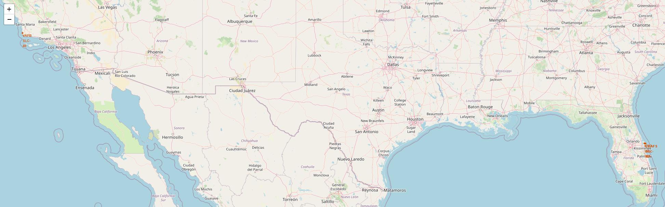
All Launch Sites
Located on coast areas, both southwest and southeast United States.
https://github.com/heath-barnett/ibm_ds_cert/blob/main/IBM-DS0321EN-SkillsNetwork_labs_module_3_lab_jupyter_launch_site_location.jupyterlite.ipynb

Slide 34
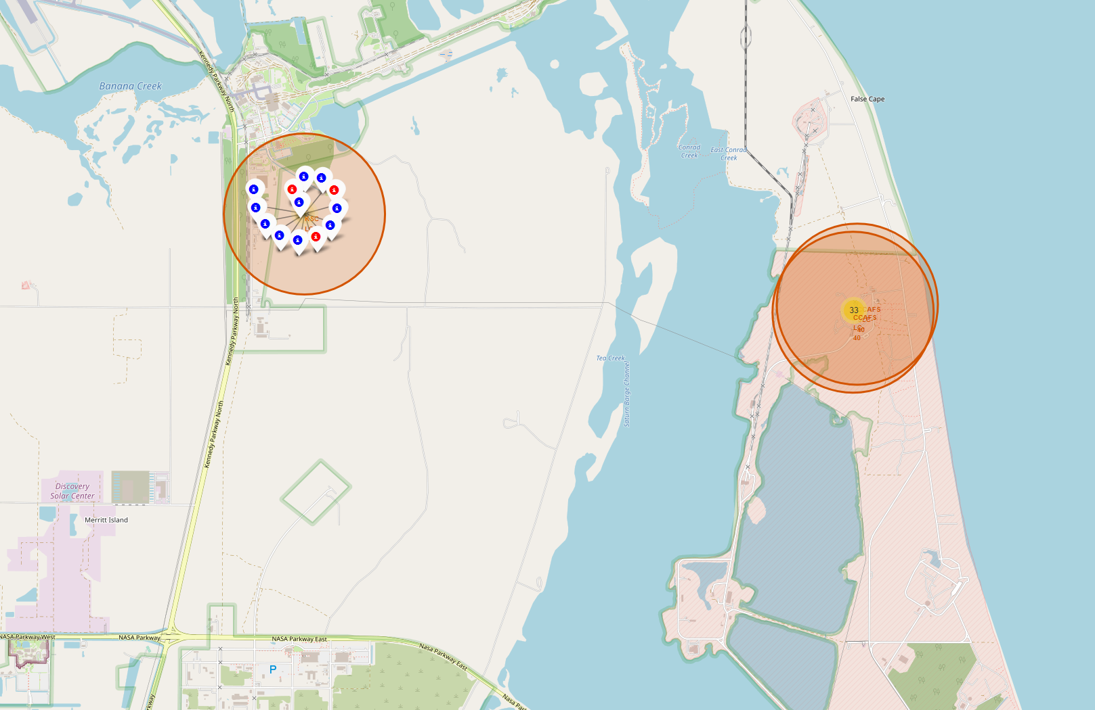
Launch Site Outcomes at KSC LC-39A
Blue indicates a successful launch, red indicates a failure.
Located in Florida, southeast coast.
https://github.com/heath-barnett/ibm_ds_cert/blob/main/IBM-DS0321EN-SkillsNetwork_labs_module_3_lab_jupyter_launch_site_location.jupyterlite.ipynb

Slide 35
Launch Site KSC LC-39A Distance to Miami Florida
def calculate_distance(lat1, lon1, lat2, lon2):
# approximate radius of earth in km
R = 6373.0
lat1 = radians(lat1)
lon1 = radians(lon1)
lat2 = radians(lat2)
lon2 = radians(lon2)
dlon = lon2 - lon1
dlat = lat2 - lat1
a = sin(dlat / 2)**2 + cos(lat1) * cos(lat2) * sin(dlon / 2)**2
c = 2 * atan2(sqrt(a), sqrt(1 - a))
distance = R * c
return distance
https://github.com/heath-barnett/ibm_ds_cert/blob/main/IBM-DS0321EN-SkillsNetwork_labs_module_3_lab_jupyter_launch_site_location.jupyterlite.ipynb
launch_site_lat, launch_site_lon, city_lat, city_lon = 28.57299, -80.64621,25.761681,-80.191788
distance_city = calculate_distance(launch_site_lat, launch_site_lon, city_lat, city_lon)
distance_city
Distance of 315.92 km.

Slide 36
Section 4
Build a Dashboard with Plotly Dash

Slide 37
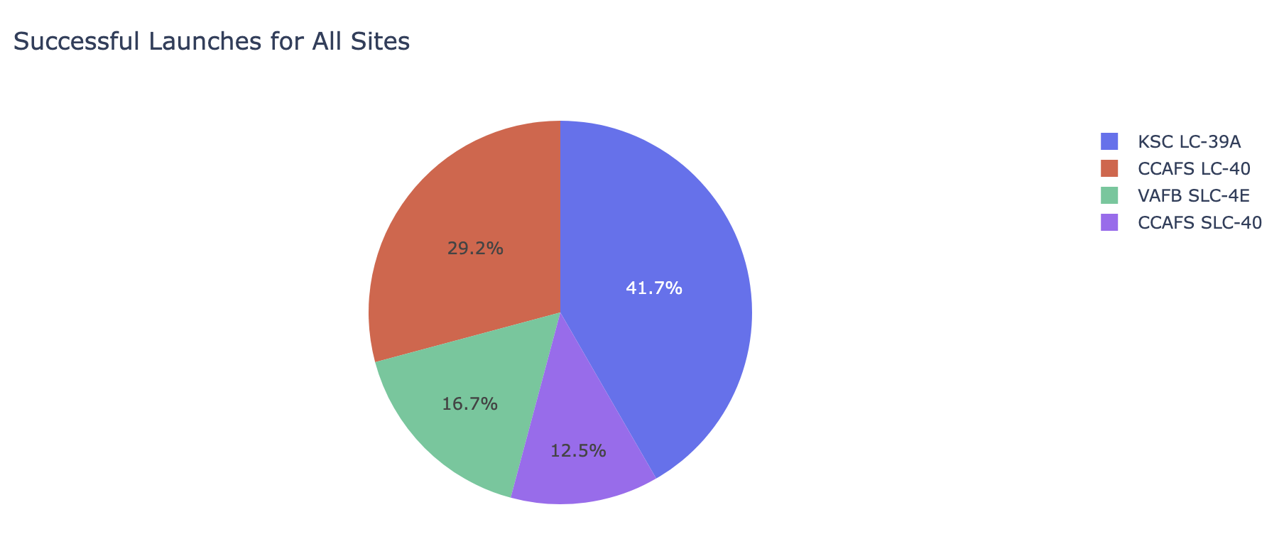
Launch Outcome
for all Sites
Launch Outcome for All Sites
KSC LC-39A has the highest success rate compared to all other launch sites.
CCAFS SLC-40 has the worst success of all launch sites.

Slide 38
Launch Site with Highest Success Rate
Launch site KSC LC-39A had the highest success rate out of all landing sites with a 76.9% success rate.
The success/failure rate at this site is represented with a pie chart.

Slide 39
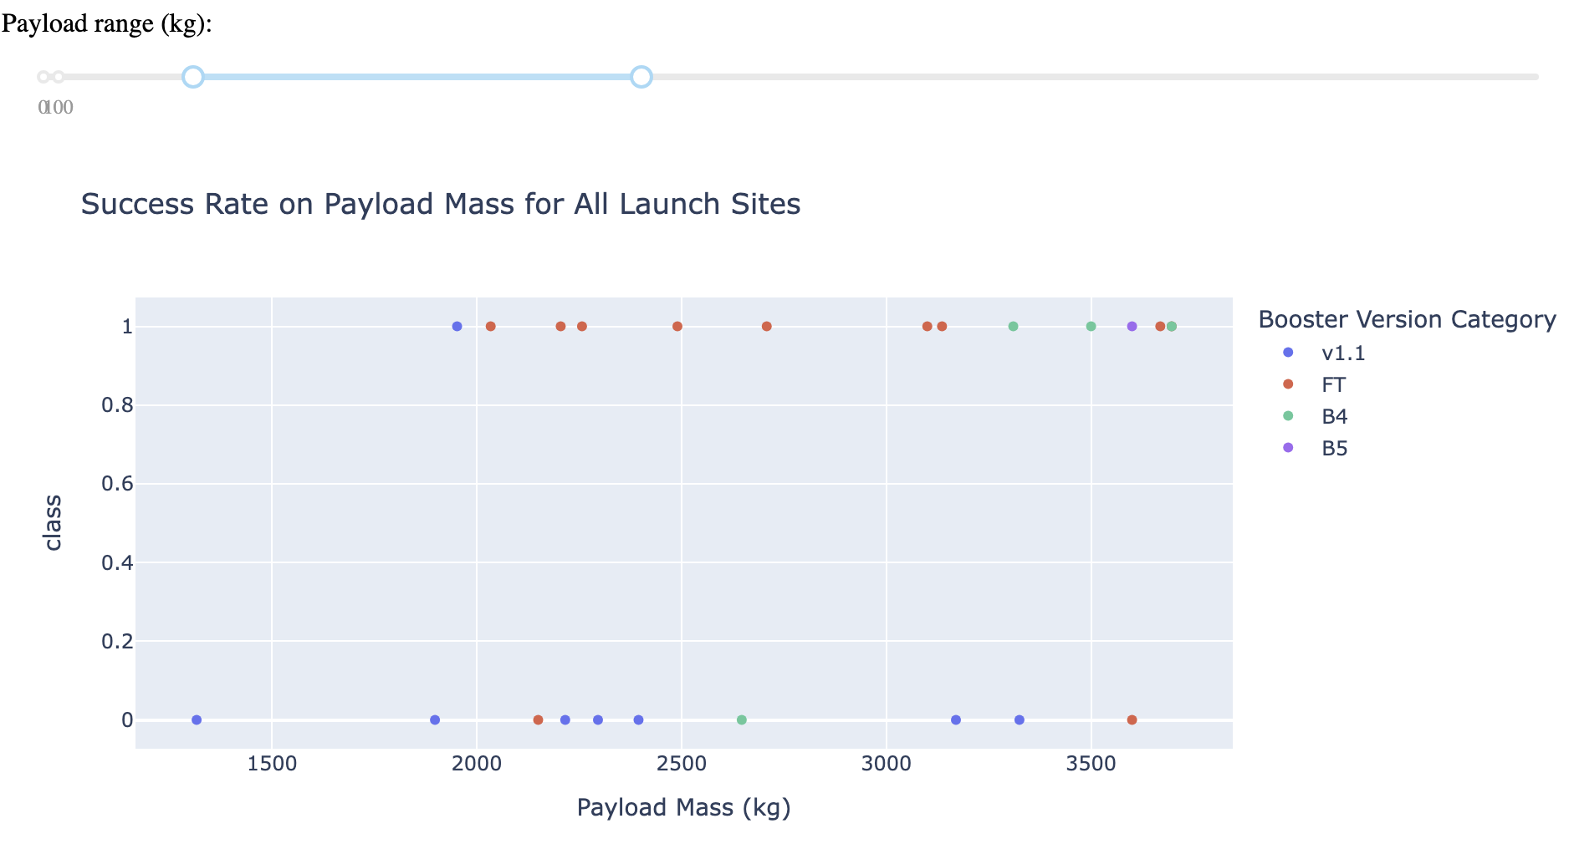
Payload vs. Launch Outcome
Payload vs Launch Outcome for All Sites
The FT booster version has the highest success rate compared to all other boosters in the payload range of 1000-4000 kg.

Slide 40
Section 5
Predictive Analysis (Classification)

Slide 41
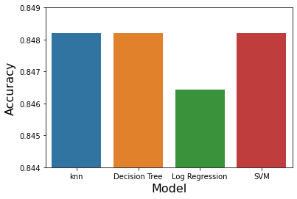
Classification Accuracy
Decision Tree Classifier was the most accurate on test data. However, it was not much better than other models.
https://github.com/heath-barnett/ibm_ds_cert/blob/main/IBM-DS0321EN-SkillsNetwork_labs_module_4_SpaceX_Machine_Learning_Prediction_Part_5.jupyterlite.ipynb

Slide 42

Confusion Matrix
Decision Tree Classifier
Decision Tree Classifier performed the best on training data with an accuracy of 87.7%.
The model did not predict outcomes any better than other models investigated.
False negatives are an issue with this model.
https://github.com/heath-barnett/ibm_ds_cert/blob/main/IBM-DS0321EN-SkillsNetwork_labs_module_4_SpaceX_Machine_Learning_Prediction_Part_5.jupyterlite.ipynb

Slide 43
Conclusions
Higher Flight Numbers is Correlated with Success
Success Rates have an upward trend since 2013.
Certain orbit launch targets are highly successful:
GEO, HEO, SSO, VLEO and ES-L1
Optimal launch site for success is KSC LC-39A
Decision Tree model was most accurate (marginally) but false negatives are an issue.

Slide 44

Thank You!

